Slide 1
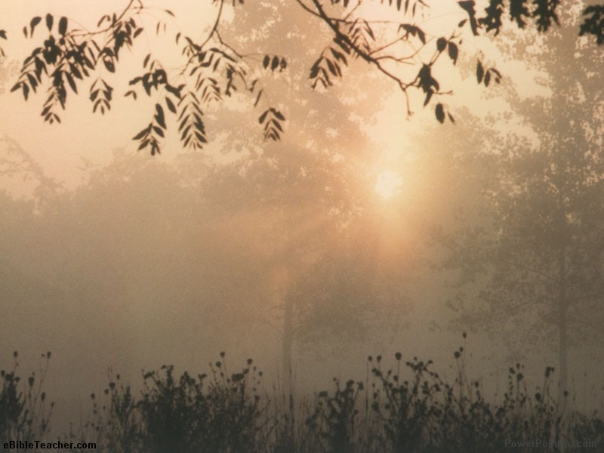
God’s Word is the Way to Blessing
Psalm 1

Slide 2
The Way to Blessing is to be grounded, growing and giving through God’s word.
The Way of Blessing is through God’s Word for 2 reasons:

Slide 3
1. The Way of Blessing is through God’s Word because Scripture is the Way of Life.
Blessing begins with Choice and Action
Choice - in the Counsel, Path & Seat you accept
Action - in the Walk, Stand & Seat you take
The Way is Defined by a Relationship to God’s Word:
your attitude …delight… affects your character
Disdain, Indifference… or Delight
Loosed or grounded… like a tree

Slide 4
2. The Way of Blessing is through God’s Word because Scripture is the Source of Life.
Blessing is to be a Firmly Planted and Strategically Placed Fruit Tree:
Firm = deep roots
Strategically Placed = connected to source
Planted = transplanted
Fruit = has purpose, ministry
Tree = slow growing, strong, imposing

Slide 7
2. The Way of Blessing is through God’s Word because Scripture is the Source of Life.
The blessed are like a tree that is growing grounded and giving through God’s Word.
Blessing is being Known by God:
Delight to:
Protect your relationship with God
Grow your relationship with God
Purpose and Strength are understood through God’s Word

Slide 8
God’s Word makes the Difference in the Journey and the Destination of Life.

